Slide 1
E - CONSERVE
Using Head Detection
The Best Energy conservation methodology

Slide 2
TOC
Overview
Problem Statement
Project objective
Insights
Target audience
Solution Proposal
Block Diagram
Implementation
Camera Specification
Budget
Progress
Project Timeline

Slide 3
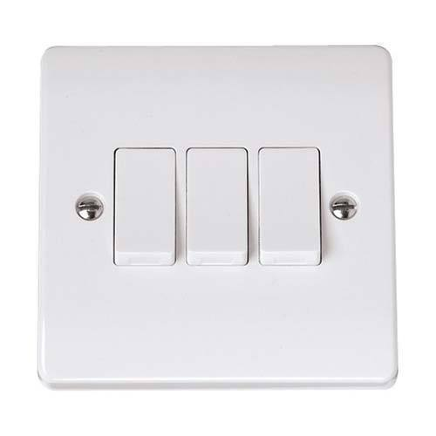
Overview
We may have came across many situations wherein we are confused in switching on particular fan or lights among different switches in a very large room.
Or we may have noticed appliances is on condition even though there are nobody sitting near it.
These are the problems, although simple but can be rooted to Increase in Energy Consumption,
It is more apparent in Large scale industries, schools, colleges and offices.

Slide 4
Problem Statement
By the survey of Times Of India , we came to know that about 90,000 unit of electrical energy gets wasted every year due to not switching off electrical appliances . Which in turn electricity bill . As we know that without electrical energy nothing can happen in this era . So it is very necessary to solve the above problem in this energy demanding society
Hence to solve the above problem we have proposed a solution called as E-Conserve

Slide 5
Project Objective
01
To design a solution which could prevent wastage of electrical energy
02
To automate switching of electrical appliances without need of searching for switches
03
To design a solution which could considerably reduce the electricity consumption and electricity bill
04
To design a user friendly and cost effective solution
05
To design a solution which gives low maintenance cost

Slide 6
Insights
On an average, let’s say Fans and lights are operated 16 hrs per day (considering Home usage as 24 hrs and Office usage as 8 hrs, so average is 16 hrs)
Fans consume 80 Watts
Lights consume 30 Watts
No. of hours of Usage per Day= 16 Hrs
Electrical Units = 110*16 = 1760 Watt Hour = 1.76 KWH
Cost per Unit = Rs.9
Electricity Cost per Day = Rs. 1.76*9 = Rs. 15.84
Electricity Cost per Month= Rs. 15.84*30 = Rs. 475.2
Electricity Cost per Year= Rs. 475.2*12 = Rs. 5702
We can considerably reduce this cost if the run time of appliances is reduced on following our algorithm

Slide 7


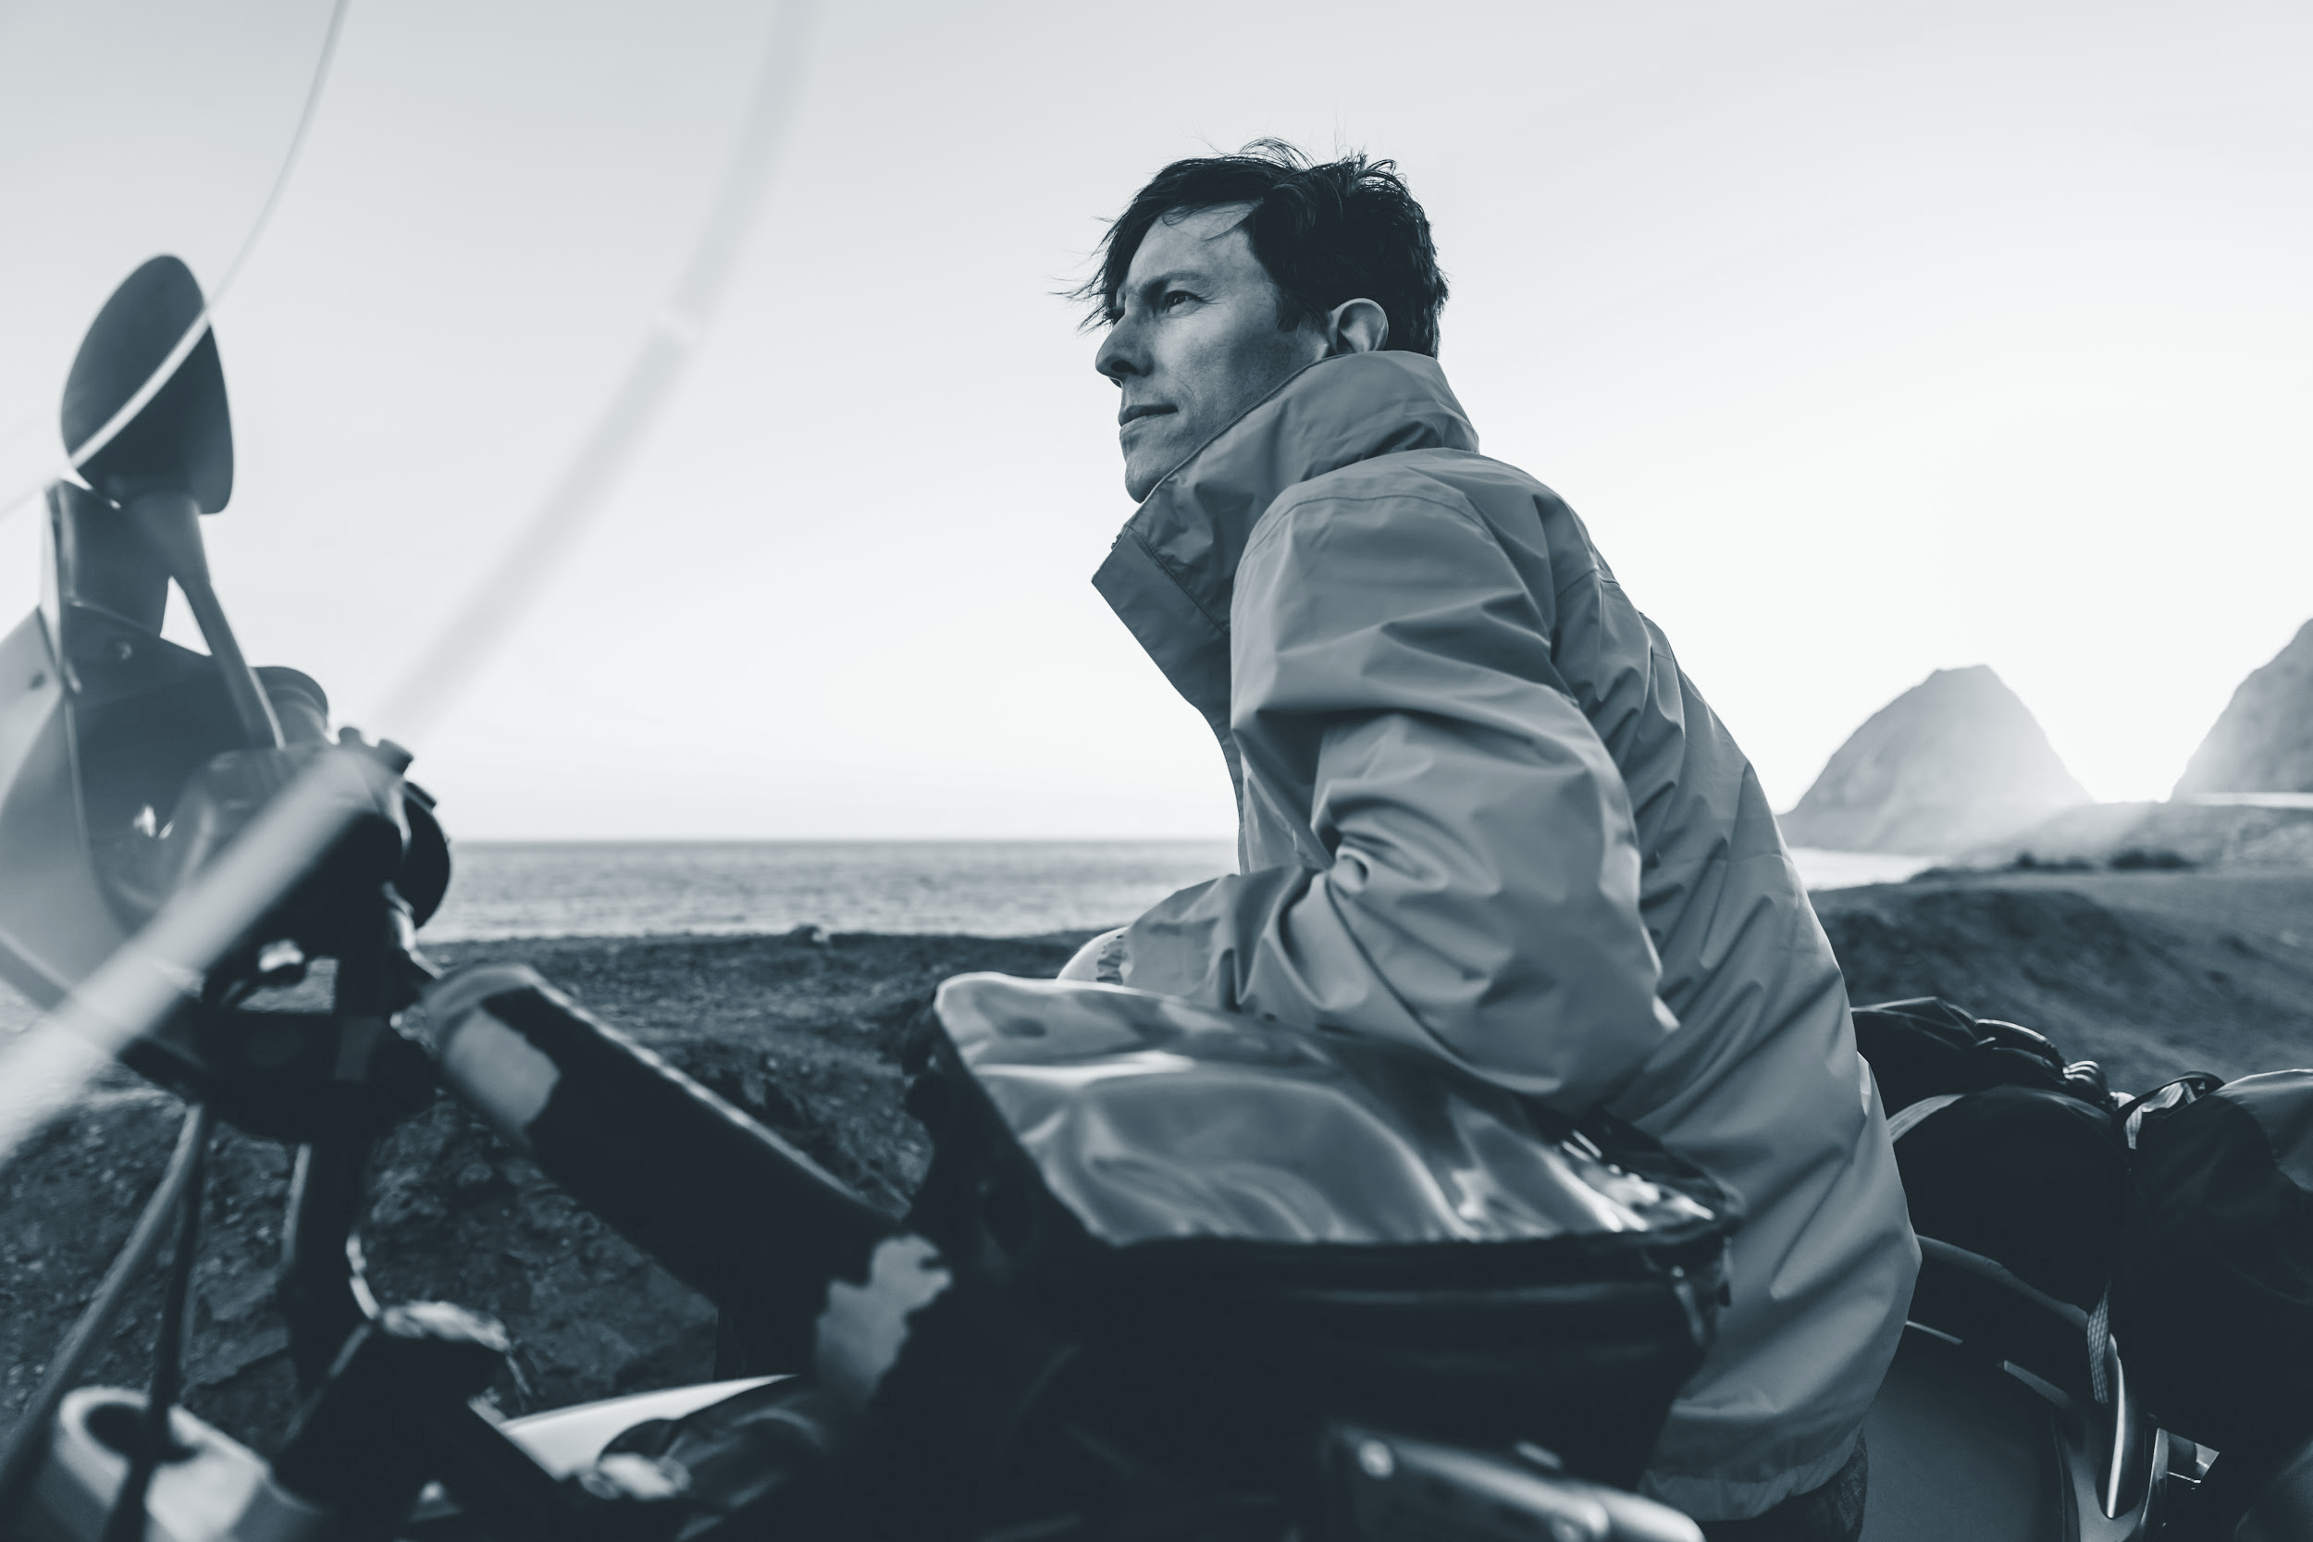
Target audience
Target audience for this project are schools , colleges , offices , industries (small scale to large scale industries ) . Large scale electrical energy consumers can be considered as the target audience for this project .

Slide 8
Solution Proposed :
In order to address the above problem we have proposed a solution called as E-Conserve. This system specifically designed for class room , offices , factories . In this system we will be having a 360 degree rotating camera which will be used to capture images of the classroom/offices/factories . This images will be processed using Deep learning algorithm such as CNN . Based on the head count the corresponding electrical appliances will be turned on or off . This is one of the efficient method for energy conservation . By this method energy can be conserved considerably .

Slide 9
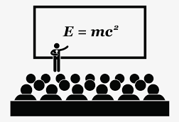


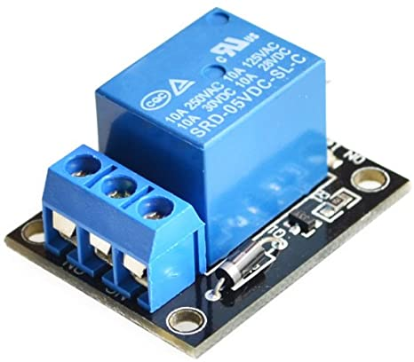
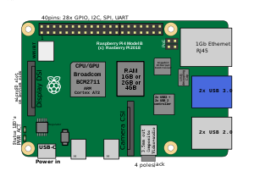

Block Diagram :
Imutils Library
Frames
Programmed

Slide 10
Block Diagram Explanation :
In this system we will be placing a 360/180 degree camera in the room .
The video output of the camera is splitted into frames using imutils library .
The frames are then fed to the Amazon Rekognition software , which in turn detects the no of heads in images .
And consolidating the head count obtained , per 360 degree rotation we will be calculating the no of person in a room .
And by applying suitable algorithm we will be switching on or off the appliances using the relay accordingly .

Slide 11

Implementation
As our camera notices people near fan and lights, it sends information regarding the position and span of people. Then the microprocessor decides which fan and lights should be on.
The fans and ambient lights are switched on until people are present near them

Slide 12
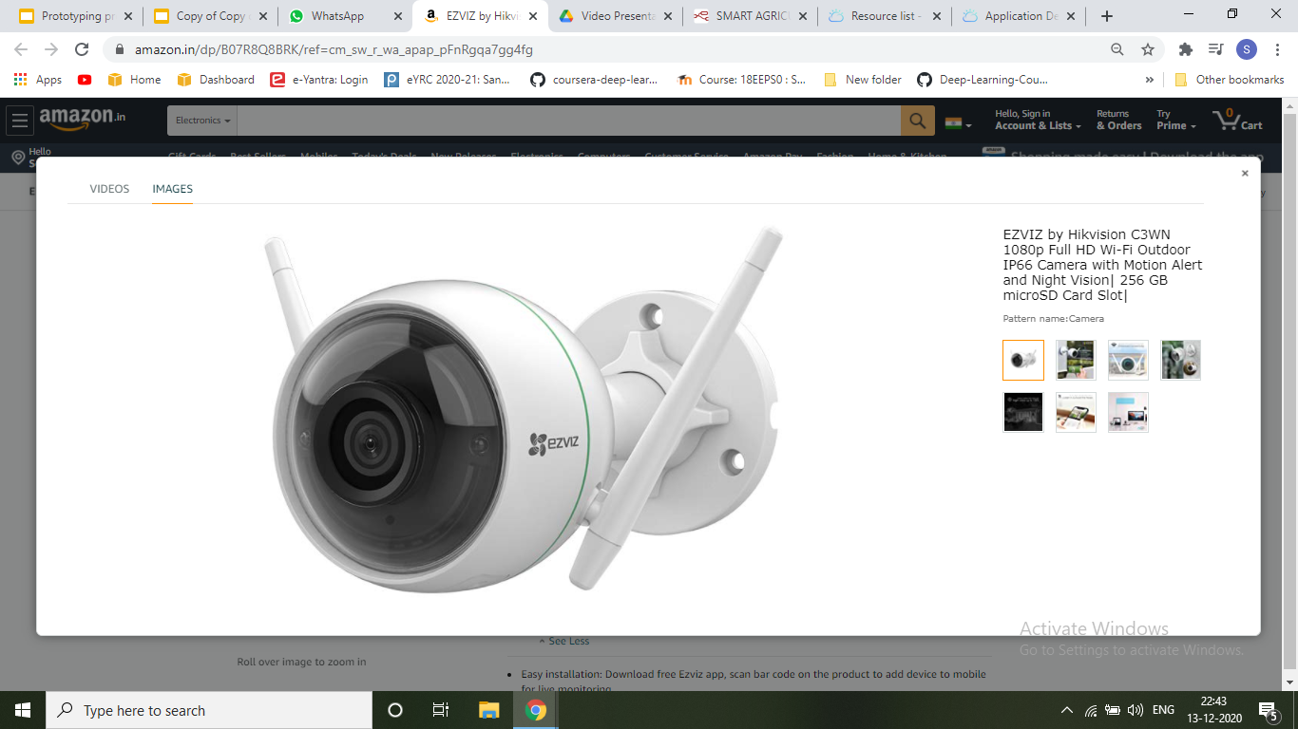
Camera Specification
Ezviz Full HD WiFi Wireless IP Security Camera CCTV
2 MP Ultra HD 1080P 8X Zoom
Night Vision Model: F1-362B.
Smart H.264 video encoding for smooth HD streaming even with low internet speed.
ULTRA HD 1080P: Stunning video quality with auto video enhance feature for crisp & clear image.
Water Proof

Slide 13
Budget
SNO | Materials & Specification | Quantity | Cost(Rs)
1 | 2MP CMOS Ultra HD 1080P 8X Zoom , Night Vision wifi enabled | 1 | 4000
2 | Robonics 5V 2 CHANNEL SOLID STATE RELAY MODULE 240V 2A OUTPUT WITH RESISTIVE FUSE | 1 | 353
3 | Raspberry pi 4 , 4 gb Ram | 1 | 4085
4 | Bulb with socket cord | 1 | 300
TOTAL |  |  | 8738

Slide 14
Project timeline
Week 1
Week 2
Week 3 -4
Week 5
Software Designing
Software Implementation and checking
Hardware Designing and Implementation
Reviewing of the model , Sorting out the error and Final Implementation

Slide 15
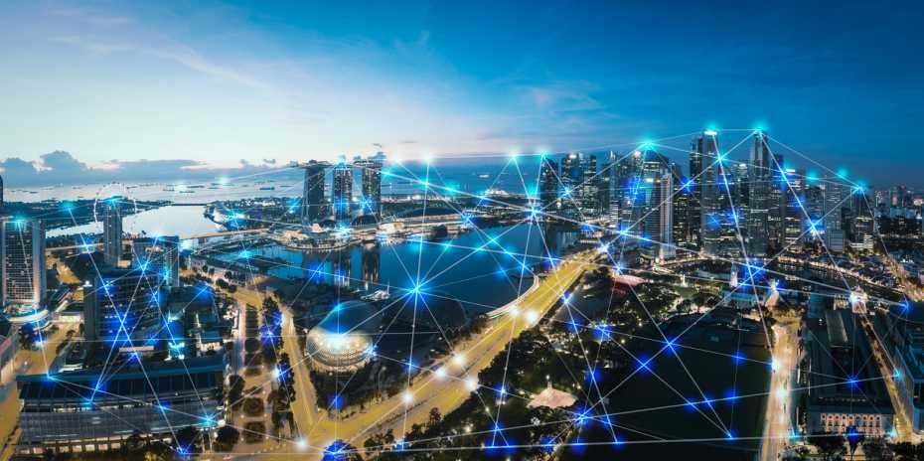
Conclusion
In this fast pace World, Electricity demand is increasing exponentially. On Forecasting the future demand, we need more resources to run the world. Hence it is necessary to Save Electricity to large extent. We hope that our product E-Conserve may contribute to this vision.

Slide 16
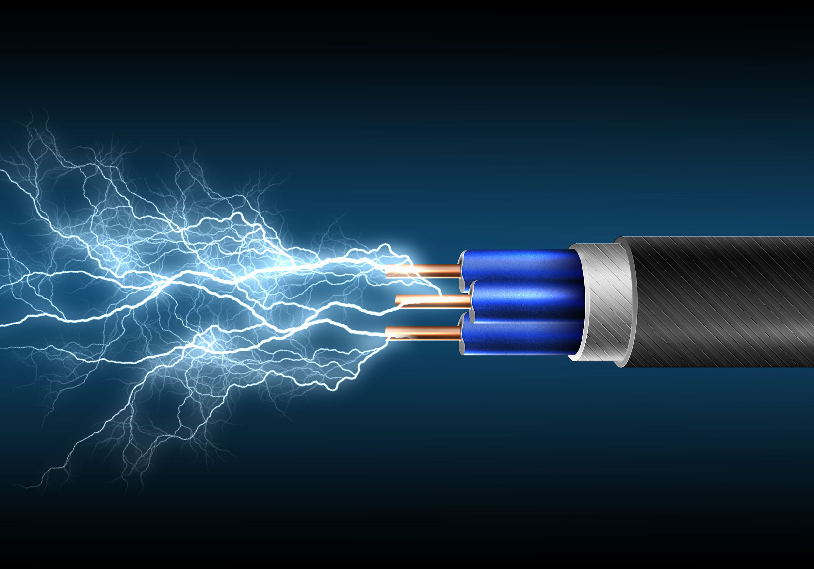
Thank you!

